Slide 1
Energy Services performance contracting
Geoff Martin
IREC

Slide 2
Energy Services Performance Contracting
Energy Services Performance Contracting is a comprehensive approach to improving Town facilities.
An Energy Services Company (ESCO) develops and implements an energy savings plan and installs the energy efficiency/renewable energy upgrades.
Perform energy audits at no upfront cost and with no obligation.
ESCO makes a proposal to the Town, and the Town chooses whether or not to move forward.
ESCO completes the project(s) and commissions the systems.
ESCO guarantees the energy savings and provides ongoing reports verifying the actual savings.
Opportunity for one-time improvements or multi-year initiative.
Notes:
Typically towns/organizations go out to bid for energy audit – costs thousands, left with report, up to town to implement recommendations (including budgeting, design, RFPs, project management). Tend to sit on shelf, big investment with not much for outcomes.

Slide 3
Advantages of ESPC
No upfront cost or obligation.
ESCO accountable for project evaluation, design, construction, and post-installation monitoring.
Guaranteed cost and energy savings.
Projects can be budget neutral, if desired.
Can include other capital improvement measures.
*Source: U.S. Department of Energy. Office of Efficiency & Renewable Energy.
“ESPC or Design-Bid-Build for Your Retrofit”.

Slide 4
Next Step
Opportunity to coordinate the process with other towns in the IREC program, potentially lowering costs.
Seeking authorization to issue a Request for Qualifications from ESCOs to work with participating towns.
Notes:
School district is looking at this opportunity now
Working with EVT on this – decided that ESPC is best model for the towns, help oversee the process in terms of helping with RFQ, making sure the right technologies are selected, appropriate design, incentives
Review of RFQ –
Meets procurement policy
Reflects the information discussed in this presentation
Specifics about Woodstock are accurate

Slide 5
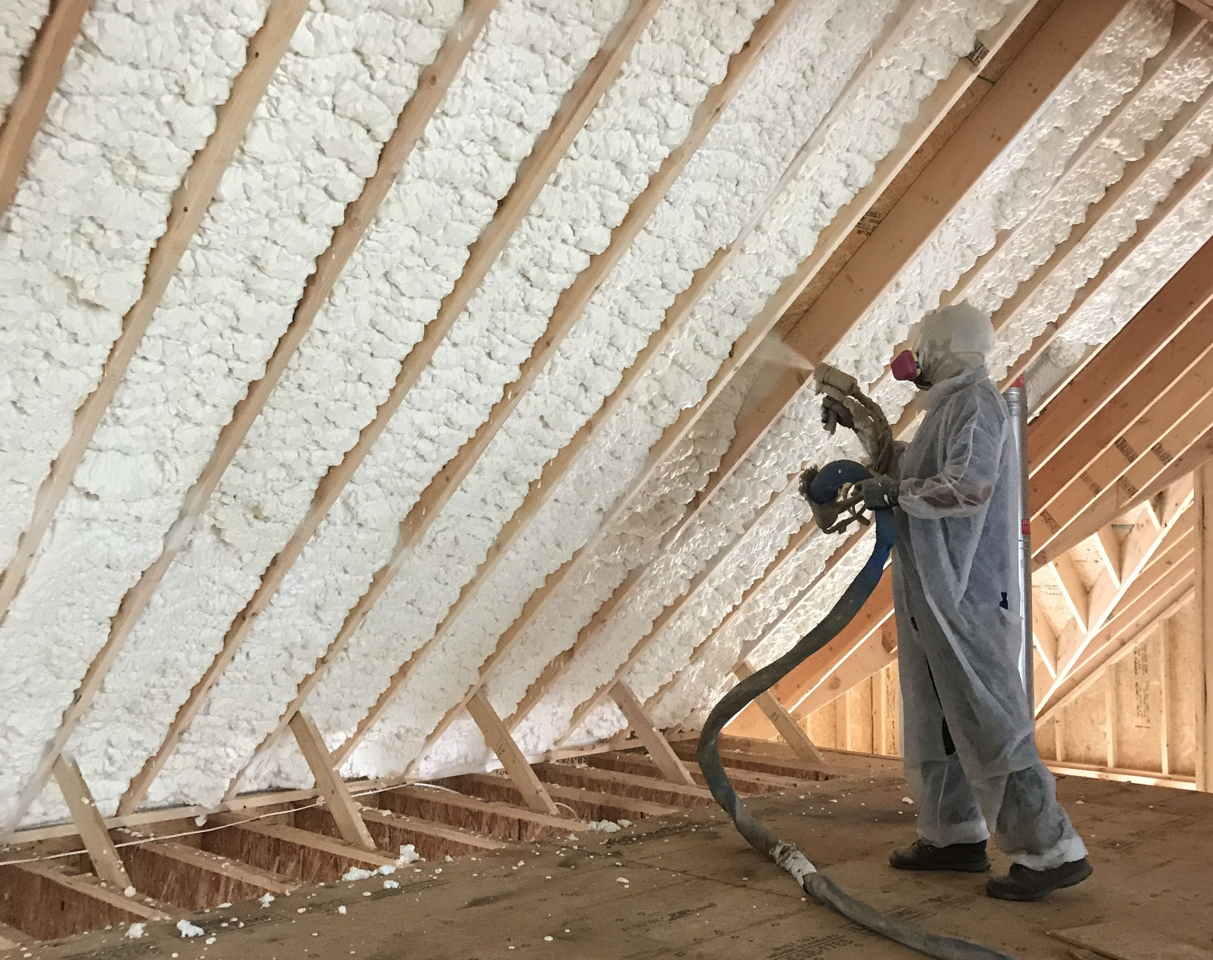
Stretch Code

Slide 6
Residential Building Energy Standards (RBES)
The Vermont Residential Building Energy Standards (RBES) is a “code that regulates minimum energy conservation requirements for new buildings as well as additions, alterations, renovations, and repairs to existing buildings.”¹
Builders must self-certify that they have met the RBES by filing an RBES Certificate with the Town.
The RBES is updated every three years, and the 2019 RBES comes into effect on September 1, 2020.
The 2019 RBES is based on the International Energy Conservation Code® (IECC) 2015 edition, with 2018 updates.
¹2019 Vermont Residential Building Energy Standards, p. 1

Slide 7
Stretch Code
Stretch Code is defined as, “a building energy code for residential buildings that achieves greater energy savings than the RBES.”¹
Municipalities have the option to adopt Stretch Code.
Regardless of whether the municipality has adopted Stretch Code, all projects that require an Act 250 permit must meet Stretch Code.
South Burlington has adopted Stretch Code.
¹2019 Vermont Residential Building Energy Standards, p. 3

Slide 8
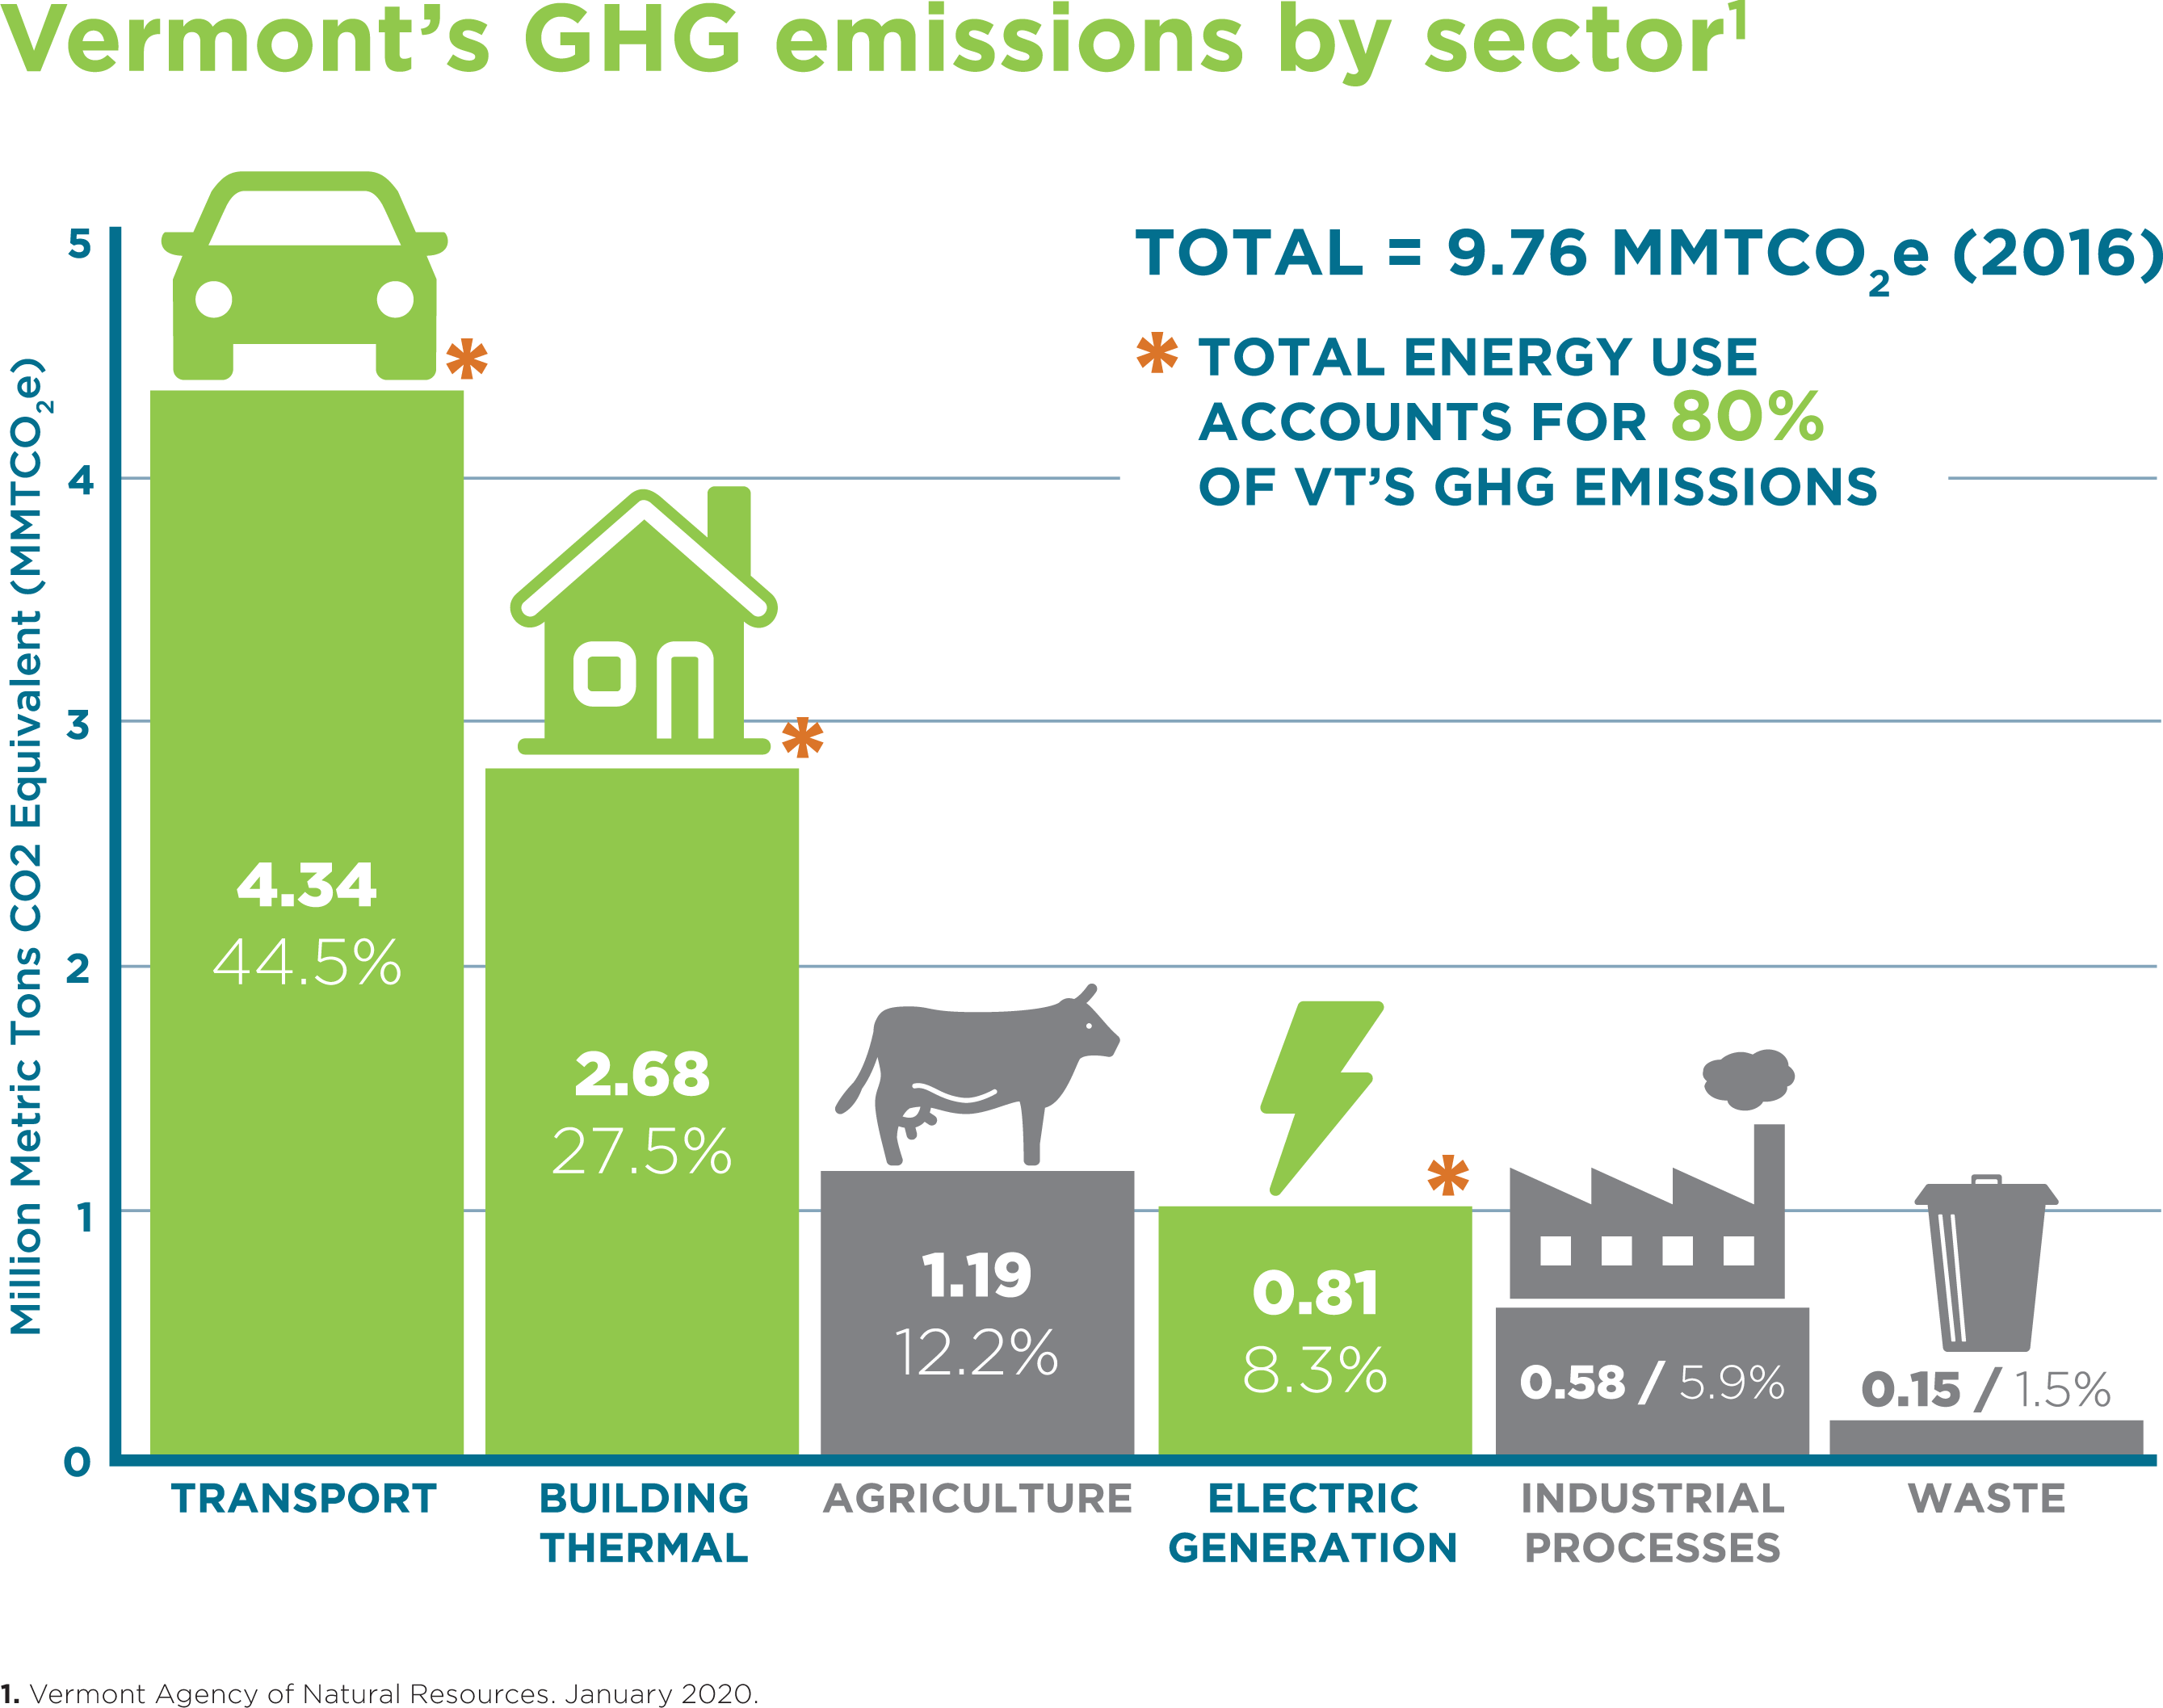
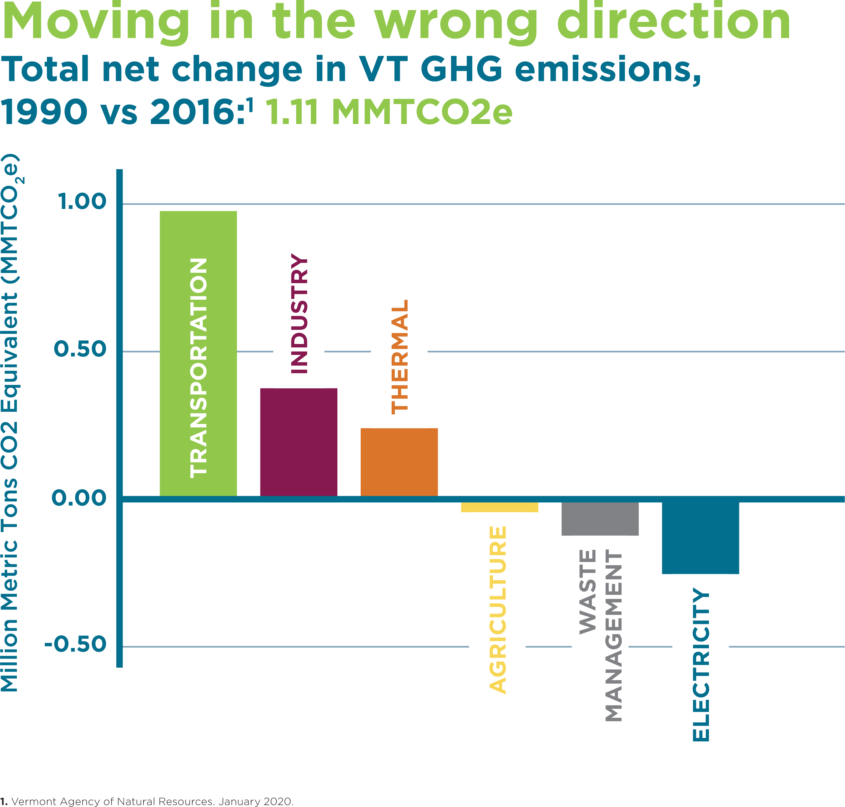
Buildings Sector – Emissions
Source: Energy Action Network
Source: Energy Action Network

Slide 9
Buildings Sector – Cost
The average Vermont home built to the current energy code comes with a $3,600/year energy bill
Additionally, most of the money spent to heat homes in Vermont leaves the Vermont economy
Source: Energy Action Network

Slide 10
State/Town Energy Goals
One goal of Vermont’s 2016 Comprehensive Energy Plan is for all new buildings to be net-zero by 2030.
Thetford’s Town Plan includes the following recommendations:
The Town shall review and adopt zoning bylaws and subdivision regulations to promote energy-efficient building and site design, and to reduce or eliminate greenhouse gas emissions and/or fossil fuel infrastructure.
The Town should encourage builders and developers to employ energy efficiency building techniques, including net zero.

Slide 11
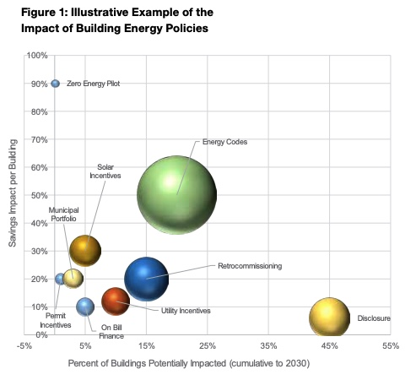
Why Adopt Stretch Code?
Stretch Code is about a 30% improvement over the 2019 RBES, meaning a significant reduction in energy use and greenhouse gas emissions over the building’s lifetime.¹
For an average new Vermont home, Stretch Code results in an annual savings of $731 compared to the 2015 RBES, and $194 compared to the 2019 RBES. If financed in a 30 year mortgage at 4.5% interest, the homebuyer realizes a positive cash flow of $114/month.²
Adopting Stretch Code would be a step towards a net-zero requirement that is measured and incremental. Contractors/architects would gain experience with higher performance construction and technologies, and be better prepared to meet a net-zero requirement when the time comes.
Source: New Buildings Institute,
Moving Energy Codes Forward: A Guide for Cities and States, 2018
¹Email from Barry Murphy, VT DPS, 06/09/20
²Final Proposed Rule Filing, Vermont Residential Building Energy Standards

